Slide 1
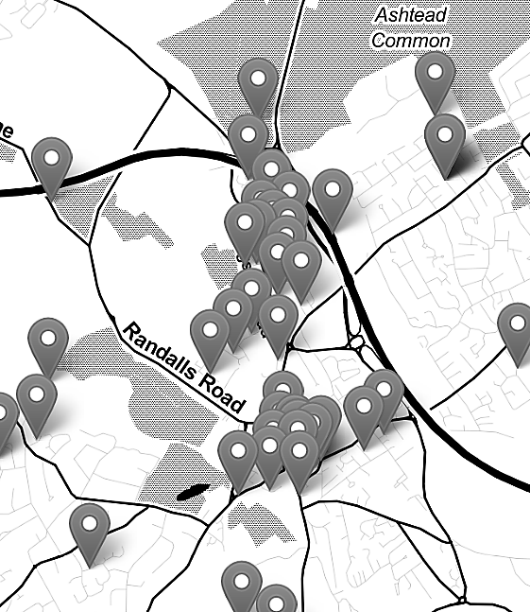

Mapping Crime Data in R: Live Code Demonstration (08/03/2023)
Nadia Kennar, Research Associate at the UK Data Service (Cathie Marsh Institute, UoM)
Copyright © 2023 University of Manchester, Cathie Marsh Institute, UK Data Service.

Slide 2
Quick poll!

Slide 3
References
R material:
Installation: https://rstudio-education.github.io/hopr/starting.html
https://www.routledge.com/Crime-Mapping-and-Spatial-Data-Analysis-using-R/Ariza-Solymosi/p/book/9780367724696
https://cran.r-project.org/web/packages/crimedata/vignettes/introduction.html
https://michaelminn.net/tutorials/r-crime/index.html

Slide 4
Survey
Please complete our short survey as you leave!

Slide 5
Thank You.
Email: nadia.kennar@manchester.ac.uk
Twitter: @NadiaKennar

